Slide 1
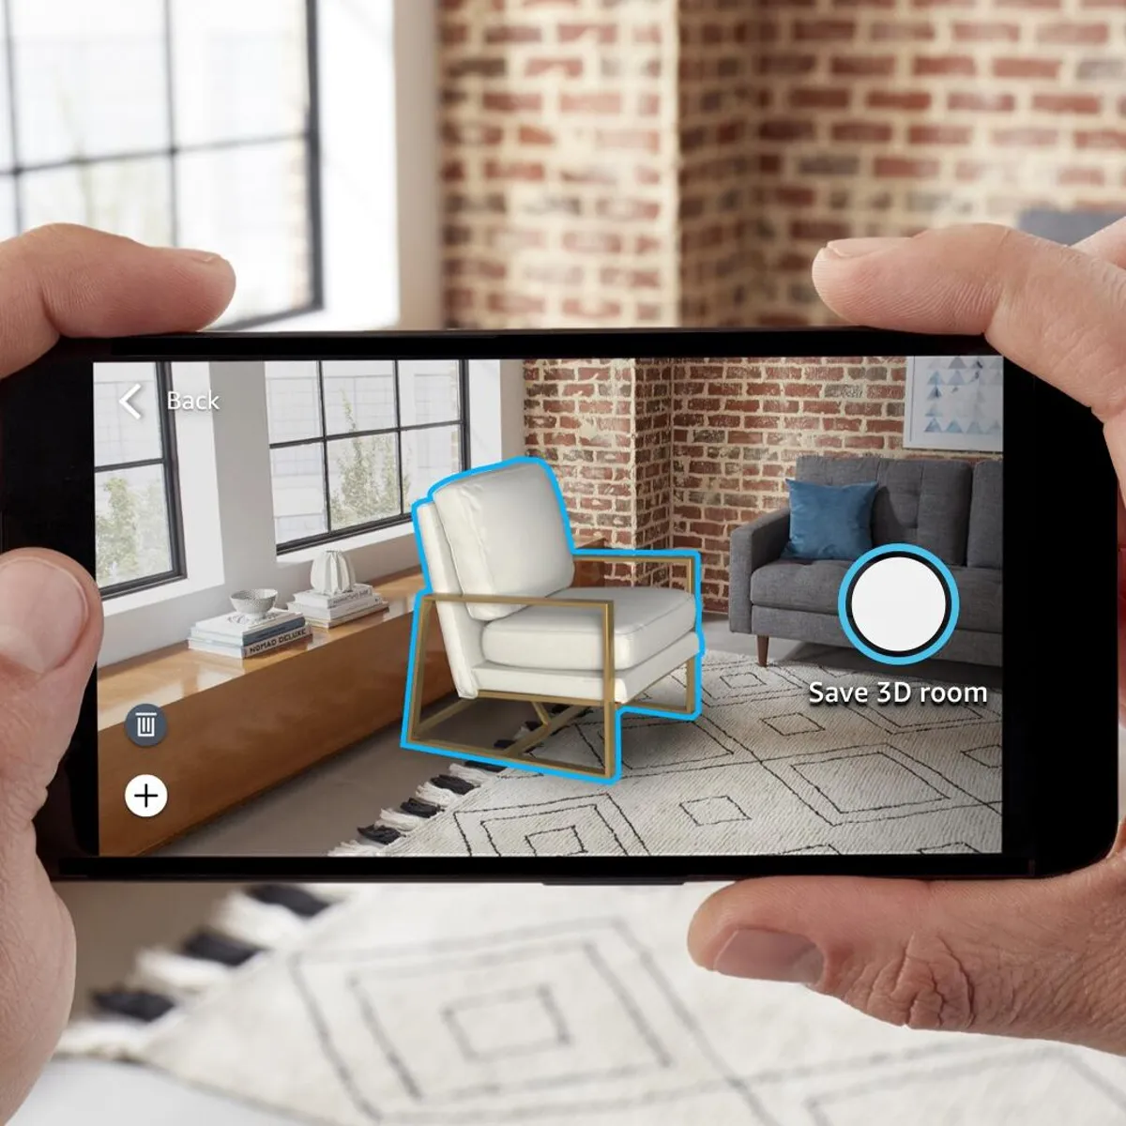
AR Furniture Placement
By: Sarah Abbadi, Alexander Emory, Ameya Deshmukh, Anushka Rao, Chase Dillard, Shreyas Sakhalkar

Slide 2
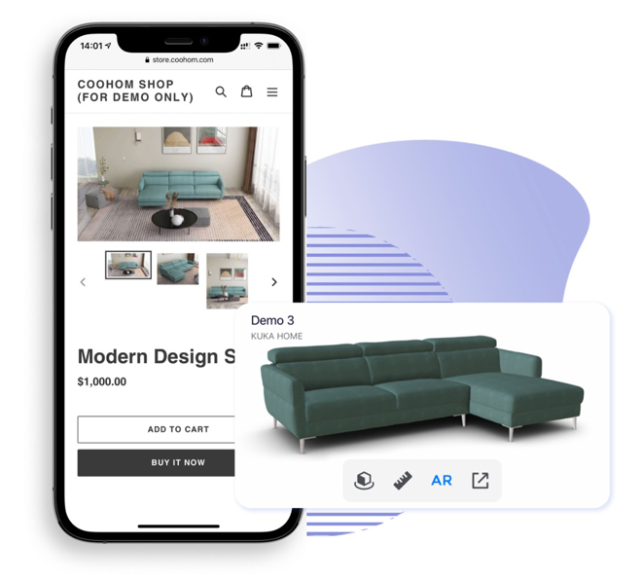
Introduction
During the pandemic, furniture ecommerce skyrocketed due to consumers not being able to go to retail stores.
Our project is an Augmented Reality app that plans to bring furniture directly to consumers. It features a furniture catalog where they can browse for and purchase furniture in their own home through the use of Augmented Reality.
The AR feature will utilize the LiDAR sensor on iPhones and iPads to create a 3D scan of the user's space and overlay an AR image of the furniture piece onto the user's environment in real time.
Link to image
Notes:
AJ

Slide 3

Functional Requirements: Product Search Feature
Search catalog
Users can search catalog items by name or description to view relevant items
Sort search results
Users can sort search results by price, popularity, etc.
Filter search results
Users can filter search results based on item type, size, color, etc.
Recommend products
Recommend products based on user query and filter selection
Recommendations weighted by popularity and product reviews
Notes:
AJ

Slide 4
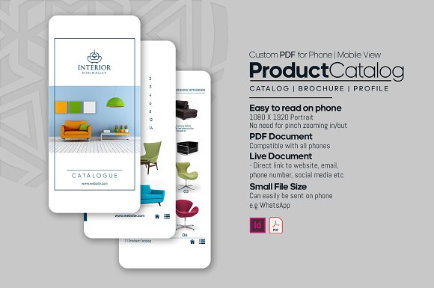
Functional Requirements: Furniture Catalog
Color and Style Matching
Sorts items by what would work under constraints like wall color, carpeting, floors, etc
Sourced Furniture
Finds furniture off of popular online furniture stores like West Elm, Serena & Lily, and Lulu and Georgia
Style Variety
Provides many different kinds of styles for users to choose from.
Notes:
Chase

Slide 5
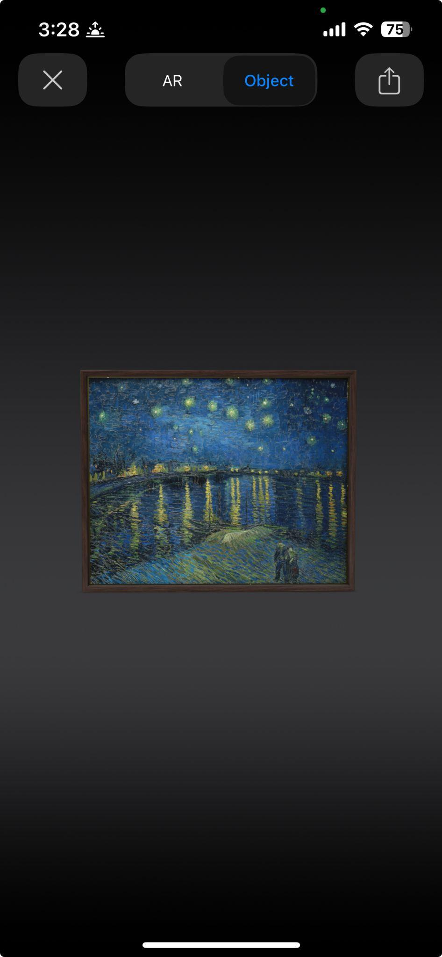
Functional Requirements: AR Furniture Placement
Room detection
The app uses the LiDAR sensor to save the scan of room so the user can save the 3D space in their profile
The sensor detects collisions with other items in the room when the user attempts to place the image in areas with incorrect dimensions
API support
The app fetches an Apple AR package from an API of augmented furniture items when the user presses the AR button
Dimensions
The AR Furniture piece must display its external dimensions in the user’s environment
Users cannot resize the dimensions of the item, however they can move the item around the room into appropriate areas
AR/Object View
The user has the ability to toggle between viewing the item in the object view and the live AR view
Notes:
Shreyas

Slide 6

Functional Requirements: Purchasing Feature
Shopping cart
Users can modify their selected furniture before purchasing
Order tracking
After ordering users can track shipped orders
Includes shipment status and delivery date
Return process
Outlines a clear return and refund policy
Initiates returns and tracks refund status
Wishlist
A list of favorited items
Can seamlessly move items from wishlist to shopping cart
Notes:
Anushka

Slide 7
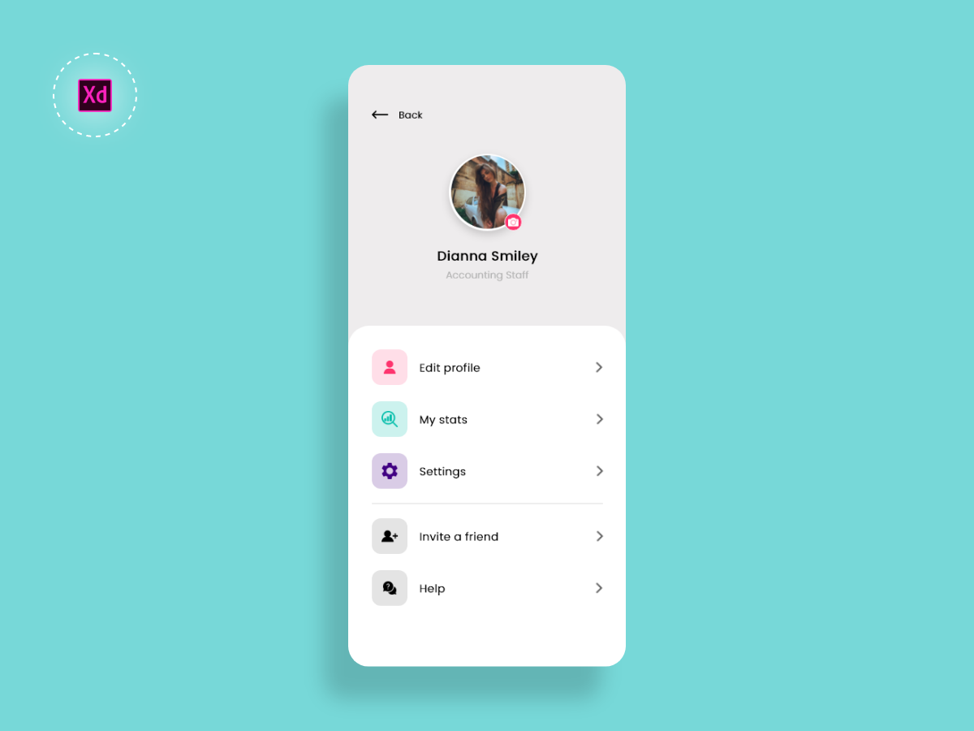
Functional Requirements: User Profile
Sign In Information
Personalized username and password
Payment information
Credit card/apple pay/paypal/apple pay information
Purchase History
Past furniture purchased through the app
Preferences
Color/theme/style preferences
Notes:
Sarah

Slide 8
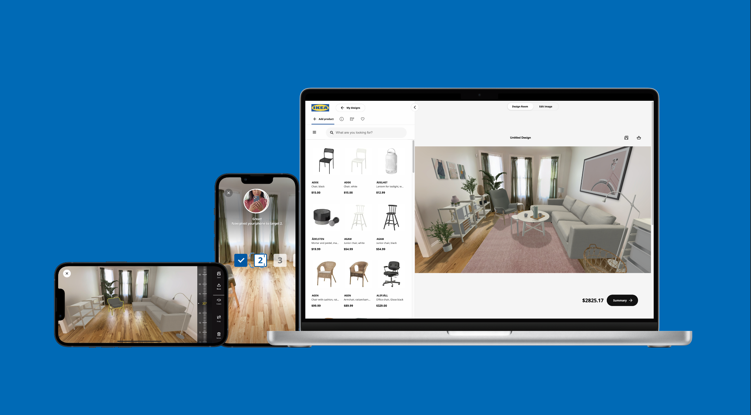
Functional Requirements: Friends & Family Sharing
AR Image Sharing
Users can share the furniture with friends by clicking the share button in the AR package, giving them the ability to place the item in their own home
Collection Sharing
Users can share favorited furniture collections and spaces with Friends and Family by long pressing on their tiles in the account menu
Notes:
Shreyas

Slide 9

Non- Functional Requirements
Usability:
The app must include a help button (Sarah)
The app should contain adjustable text/color features to accommodate everyone (AJ)
Performance(Anushka):
The app must take < 10 seconds to load AR image into environment
Supportability(Shreyas):
The app should allow frequent updates to products in the catalog
The app should allow continuous bug fixes
Implementation(Chase):
App must use IOS
Notes:
Chase

Slide 10

Team Member Responsibilities
Sarah Abbadi: research and outline user profile feature
Anushka Rao: research and outline purchasing feature
AJ Emory: research and outline product search feature
Chase: research and outline furniture catalog feature
Shreyas: research and outline AR Furniture Placement feature
Ameya: research and outline AR furniture placement (2 reqs.) & Sharing (2 reqs.) features
Notes:
Sarah

Slide 11

Potential Challenges
Limited website capabilities
Lack of experience using AR
Difficulty with app development and API integration
Lack knowledge of operating systems that support AR APIs
Notes:
Anushka

Slide 12

Potential Strategies
Limit implementation to an app
Using an API to build off of
Conduct additional research for app development
Limit app to IOS operating system
Notes:
Sarah

